Slide 1
RegEx
Lightning talk 2017-09-15
By Arnold BARNA

Slide 2
Regex (= regular expressions)
Text/string processing; anywhere, where input is textual
Validate text
Analyse text
Extract from text
Edit text
Replace in text
Delete substrings text

Slide 3
Application examples
Data validation Is hello@@anywhere;com a valid email address?
Data/Web scraping Browser: what is between the tags? <head>^%$@^&#%</head>
Data wrangling (convert from one format to another)

Slide 4
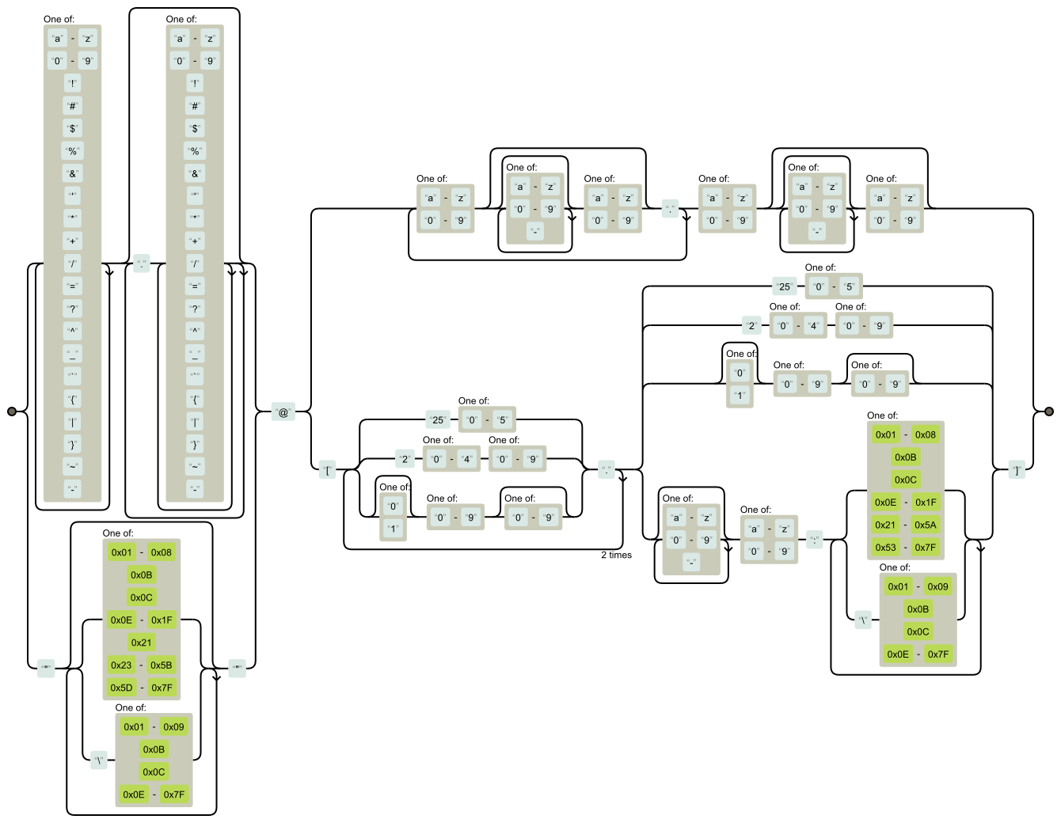
Email validation railroad diagram

Slide 5
Regex
Input for regex processor:
A string to process
A string with the pattern

Slide 6
General Email Validation Regex
RFC 5322 Official Standard:
(?:[a-z0-9!#$%&'*+/=?^_`{|}~-]+(?:\.[a-z0-9!#$%&'*+/=?^_`{|}~-]+)*|"(?:[\x01-\x08\x0b\x0c\x0e-\x1f\x21\x23-\x5b\x5d-\x7f]|\\[\x01-\x09\x0b\x0c\x0e-\x7f])*")@(?:(?:[a-z0-9](?:[a-z0-9-]*[a-z0-9])?\.)+[a-z0-9](?:[a-z0-9-]*[a-z0-9])?|\[(?:(?:25[0-5]|2[0-4][0-9]|[01]?[0-9][0-9]?)\.){3}(?:25[0-5]|2[0-4][0-9]|[01]?[0-9][0-9]?|[a-z0-9-]*[a-z0-9]:(?:[\x01-\x08\x0b\x0c\x0e-\x1f\x21-\x5a\x53-\x7f]|\\[\x01-\x09\x0b\x0c\x0e-\x7f])+)\])
.NET (general pattern match)
^\w+([-+.']\w+)*@\w+([-.]\w+)*\.\w+([-.]\w+)*$
C#
^(?(")(".+?(?<!\\)"@)|(([0-9a-z]((\.(?!\.))|[-!#\$%&'\*\+/=\?\^`\{\}\|~\w])*)(?<=[0-9a-z])@))(?(\[)(\[(\d{1,3}\.){3}\d{1,3}\])|(([0-9a-z][-\w]*[0-9a-z]*\.)+[a-z0-9][\-a-z0-9]{0,22}[a-z0-9]))$

Slide 7
Simple Examples
Regex String | Rule | Matches | Doesn’t match
“[abc]” | "a", "b", or "c" | Nebraska | Ohio
“[^hio]” | Anything BUT “h“, “I” or “o” | Ohio Cowboys | Ohio
“v{3}” | “v” three times | Nevvvvada | Nevvada
“yo.” | Any three-character string starting with “yo” | York | Ork
“[^hc]at” | No “h” or “c” before “at” | Rat, Bat | Cat, Hat

Slide 8
Simple Examples
Regex String | Rule | Matches | Doesn’t match
“H(ä|ae?)ndel” |  | “Handel’s in da house” “DJ Händel” “Haendel rocks” | “Hndel’s works”
\d\d | 2 digit | Route 66 | 5 Stau auf der Autobahn A4
\D\D | 2 non-digit | FA155 | 45823
\w | [A-Za-z0-9_] | 4cjv_tr#^$ | !@$@

Slide 9
Regex vs. String Methods
Regex: when searching for a specific pattern in a string
String Methods: When searching for a specific string

Slide 10
Regex vs. String Methods
String Methods | Regex Expression
myString.StartsWith(“Green”) | “^Green”
myString.EndsWith(“Fox”) | “Fox$”
myString.Contains(“Alpaga”) | “Alpaga” or [aglp]
myString.Replace("old", "new") | “s/old/new/”

Slide 11
Real world usage
Poker hand and card validation with and without regex

Slide 12

Example from Sortable Poker Hand
French card notation: e.g. “KS” “2H” “5C”
Ranks: 2, 3, 4, 5, 6, 7, 8, 9, T(en), J(ack), Q(ueen), K(ing), A(ce)
Suits: S(pades), H(earts), D(iamonds), C(lubs)

Slide 13
Valid inputs
Valid card: „<Rank><Suit>”
Acceptable: “2H” “td”
Not acceptable: “c9” “c99” “” etc

Slide 14
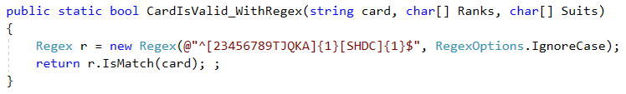
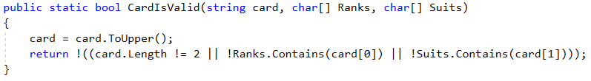
Card validation

Slide 15
Card validation pattern
“^[2-9TJQKA][SHDC]$”
^: the string must start with the pattern (String.BeginsWith())
[2-9TJQKA]: Any of these character once (Ranks)
[SHDC]: Any of these character once (Suits)
$: the string must end with the pattern (String.EndsWith()

Slide 16
Thank you for the attention
Available on GitHub:
Code:
https://github.com/greenfox-academy/bramble100/tree/master/week-02/SortablePokerHands
Slides:
https://github.com/greenfox-academy/bramble100/tree/master/week-02/lightning-talk

